Slide 1
DBSCAN Clustering

Slide 2
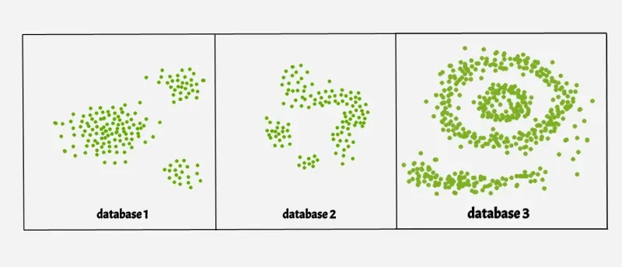
What is DBSCAN?
DBSCAN stands for Density-Based Spatial Clustering of Applications with Noise.
It’s a clustering algorithm that finds groups in data that are close together.
Good for finding clusters of any shape and handling noise & outliers (points that don’t belong anywhere).

Slide 3
How DBSCAN Groups Points
DBSCAN puts data points into 3 types:
Core Points: Enough neighbors around them.
Border Points: Next to core points but not dense enough on their own.
Noise Points: Too far away — considered outliers.

Slide 4
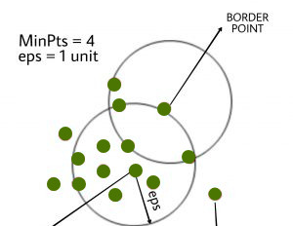
How It Works (Step-by-Step)
Find Core Points: See if each point has enough neighbors within a certain distance (eps).
Form Clusters: Connect core points and their nearby points to make clusters.
Connect Points: If points are connected by a chain of neighbors, they stay in the same cluster.
Label Outliers: Points that don’t fit in any cluster are marked as noise.

Slide 5
Key Parameters
eps (ε): The distance used to check if points are neighbors.
Too small → lots of noise.
Too big → clusters might merge.
min_samples: The minimum number of neighbors to be a core point.
More samples → stricter clusters → fewer outliers.

Slide 6
Special Features of DBSCAN
✅ Handles odd shapes, unlike K-Means (which likes round clusters).
✅ Finds outliers easily.
✅ Doesn’t need you to pick the number of clusters beforehand!
⚠️ Works well for large datasets but can use lots of memory if not handled carefully.

Slide 7
DBSCAN vs K-Means
Feature | DBSCAN | K-Means
Number of Clusters | Automatic | You must choose
Cluster Shape | Any shape | Round or oval
Handles Outliers? | Yes | Not well
Main Parameters | eps, min_samples | Number of clusters only

Slide 8
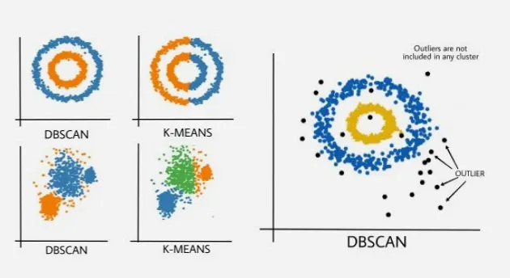

Slide 9
How Good is DBSCAN?
Silhouette Score: Shows how clear the clusters are (closer to +1 = better!).
Adjusted Rand Index: Compares clusters to real answers if you have them (closer to 1 = perfect match).

Slide 10
Related Algorithms
OPTICS: Like DBSCAN but better for different densities.
HDBSCAN: Even better! Finds clusters at many densities. No need to choose eps

Slide 11
Using DBSCAN in Python
DBSCAN is part of scikit-learn (sklearn).
After running it, the clusters are in labels_.
If you see -1 → that point is noise!

Slide 12
Thankyou

